Slide 1

Farm AI – Smart Agriculture Assistant
A Mobile Application for Farmers
BY Team Driod Dudes:
Aniket Raj
Abhigyan Sinha
Ansh Aryan
Bipasha Chakraborty
Ayush Srivastava

Slide 2
Tools and Technologies
App Development
Frontend
Backend
Android Studio with Kotlin
XML Layouts for UI design
Firebase for data & auth
Machine Learning
APIs Used
TensorFlow Lite for detection
Mandi prices, Weather, Gov. Schemes

Slide 3
Core Modules in Farm AI
Market Price Module
Real-time mandi rates (wheat, potato)
Soil Analysis Module
Input N, P, pH, Moisture, Temp → Crop recommendation
AI-Based Disease Detection
Upload image to detect crop disease
Crop Calendar Module
Based on location and weather data
Farmer Forum
Post and interact with community
Schemes Module
List of government agricultural schemes

Slide 4
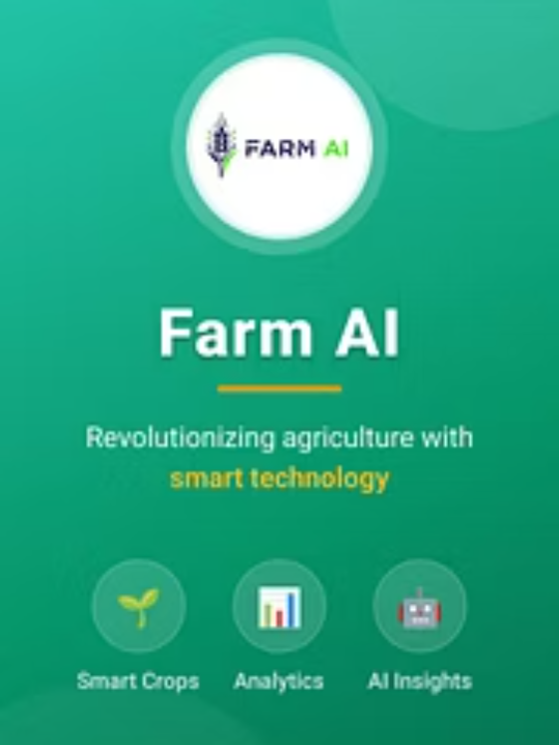
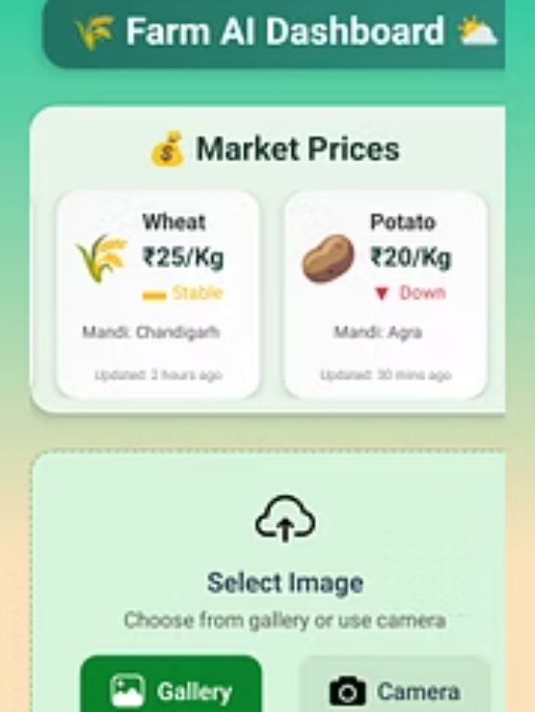
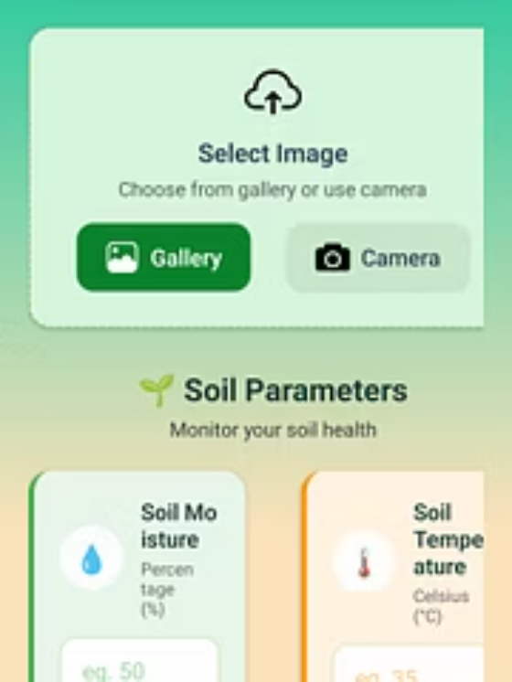
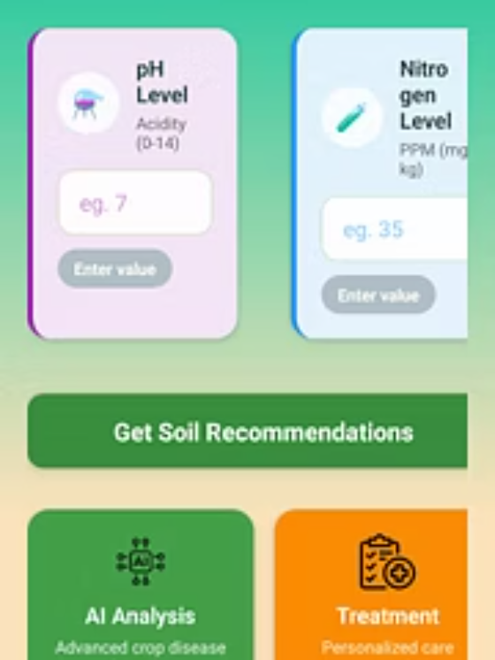
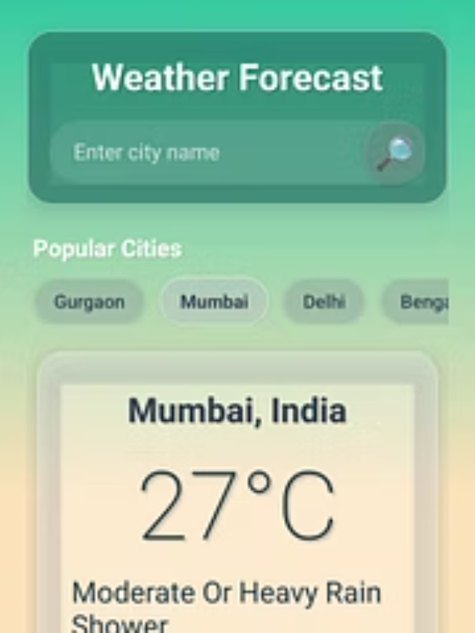
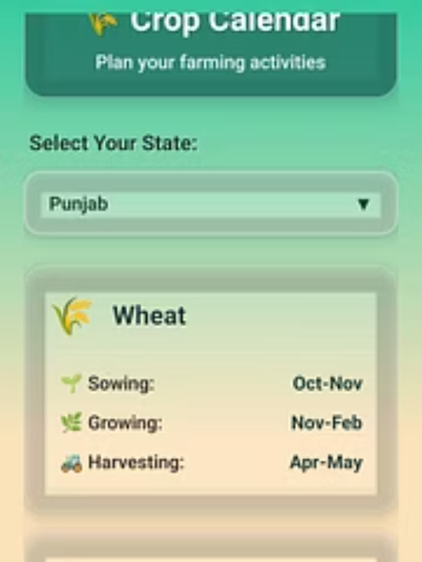
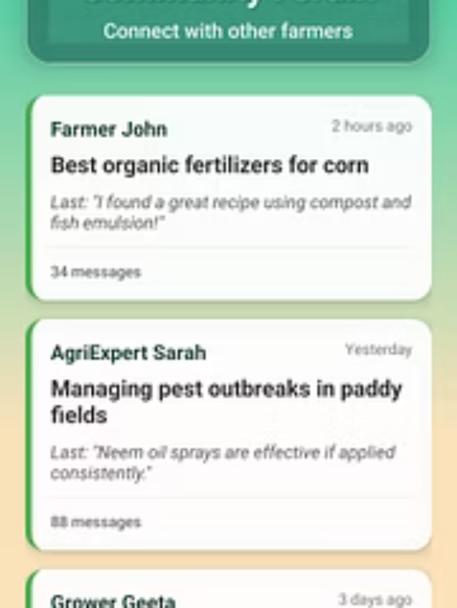
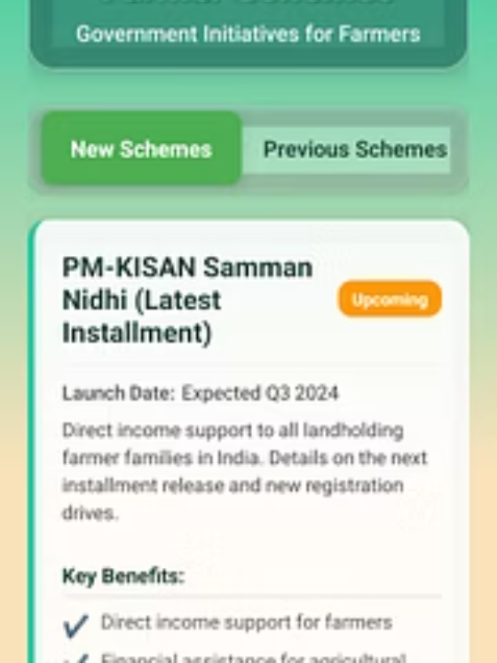
User Interface
Farm AI provides an intuitive and accessible interface, designed for ease of use by farmers of all tech proficiencies. Each module is carefully crafted for a seamless user experience, making complex agricultural data simple to access and act upon.

Slide 5
Backend and ML Integration
Firebase Use
ML Use
Realtime Database for forum posts
CNN model for disease classification
Authentication for secure access
TFLite integration for Android
Cloud Storage for image uploads
On-device inference for speed

Slide 6



Final Output and What’s Next
Current Achievements
Accurate crop prediction based on historical data
Real-time mandi data for market insights
Functional community forum & peer support
Effective disease classification using CNN models
Next Steps & Future Vision
Expand AI models for advanced yield optimization
Integrate real-time weather & soil sensor data
Enhance market access with deeper financial insights
Develop scalability for diverse farm sizes & crop types

Slide 7
Contribution Area
1
Aniket Raj
App architecture, module integration, Firebase database and auth setup
2
Ansh Aryan
Soil analysis & crop recommendation logic, testing, bug fixing, team coordination
3
Abhigyan Sinha
UI/UX design, XML layouts, navigation between modules
4
Bipasha Chakraborty
Government scheme module, crop calendar logic, API integration (weather/mandi)
5
Ayush Srivastava
Soil analysis & crop recommendation logic, testing, bug fixing, team coordination

